Slide 1
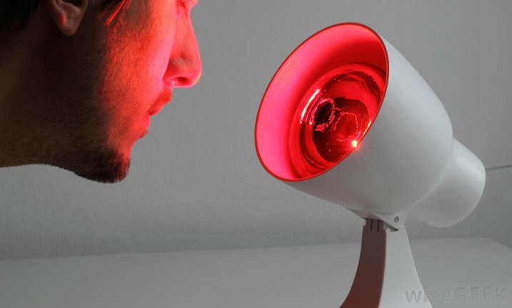
Infrared treatment light
principles of operation
function
use
scientific principles
construction
components
system diagram
inputs/outputs
troubleshooting
identifying common faults
replacing components
rectifying faults
18.4.2 Maintain an infrared treatment light
Unit C18.4 Maintaining Physiotherapy Equipment
Module 279 19 C Medical Instrumentation II
©
dr. Chris R. Mol, BME, NORTEC, 2015

Slide 2
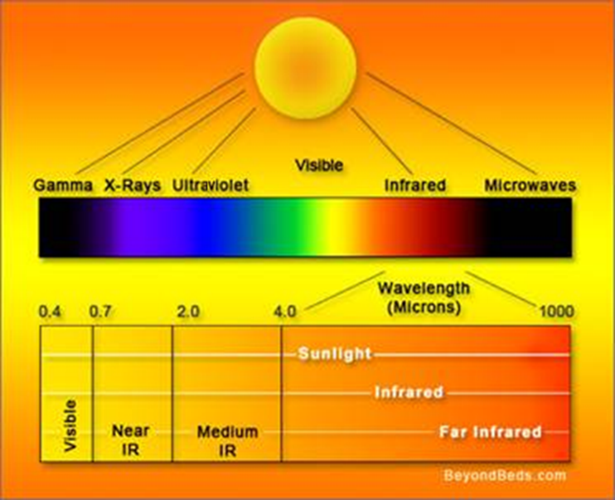
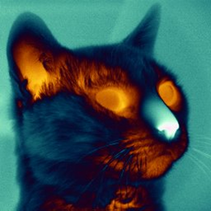
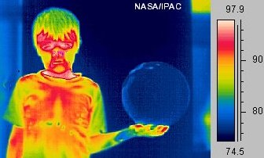
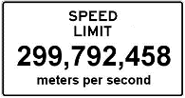
Infrared radiation
Infrared ‘light’ immediately follows red light on the electromagnetic spectrum. Infrared (IR) light energy is broken down into three groups:
Near Infrared (IR-A) is used by most home therapy devices (700 - 1400nm wave length).
Medium Infrared (IR-B) is used in household electronic devices such as remote controls.
Far Infrared (IR-C) or thermal infrared is the largest part of the IR spectrum, used for heating of buildings, etc.
Wavelength = (Speed-of-light) / Frequency
infrared pictures
©
Infrared treatment light
dr. Chris R. Mol, BME, NORTEC, 2015

Slide 3
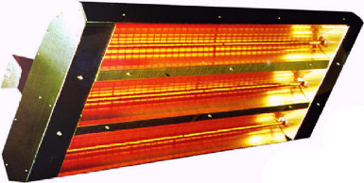
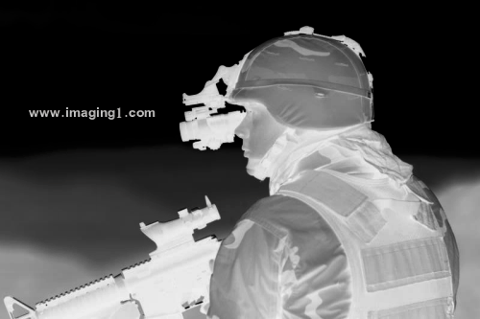
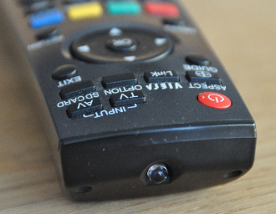
Use of Infrared light
Infrared lamps are electrical devices which emit infrared radiation.
Infrared lamps are commonly used in radiant heating for industrial processes and building heating.
Infrared lamps are also used for some night vision devices (example: military).
Infrared lamps are used in certain scientific and industrial instrument for chemical analysis of liquids and gases.
Infrared LEDs are used for communication over optical fibres and in remote control devices. Infrared is the most common way for remote controls to command appliances.
©
Infrared treatment light
dr. Chris R. Mol, BME, NORTEC, 2015

Slide 4
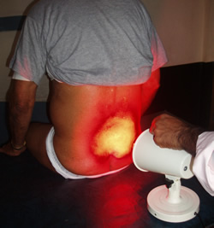
How Does it Work?
In infrared light therapy, (red light energy and) invisible near-infrared energy is absorbed in the cells. The body experiences this energy as a gentle radiant heat.
The longer the wavelength of the light, the deeper it penetrates into the body. IR radiation is more useful than the visible radiation for heating our body, because we absorb most of it, compared to a strong reflection of visible light.
For skin applications, short wavelengths (620nm-700nm) are used. For deeper laying organs, bones, joints, etc. longer wavelengths are used (800-1000nm), which penetrate up to 4 cm beneath the skin.
Once absorbed, the light energy (heat) kicks off a series of metabolic events, stimulating the body’s natural processes on a cellular level. A main effect is the increase in local blood flow through widening of the capillary blood vessels.
Therapeutic effects of heat include reducing pain, decreasing joint stiffness, reducing inflammation, etc.
©
Infrared treatment light
dr. Chris R. Mol, BME, NORTEC, 2015

Slide 5
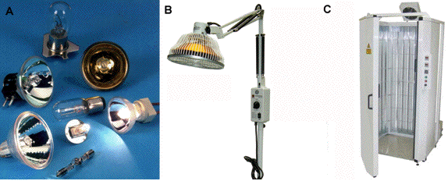
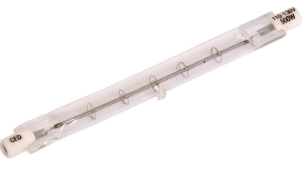
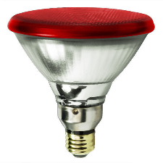
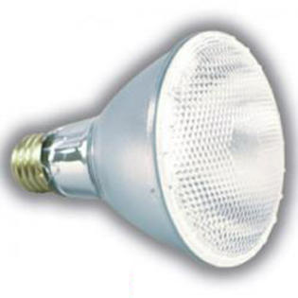
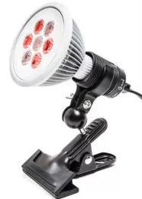
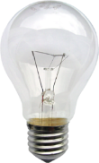
A wide variety of infrared lamps
Tungsten-Halogen (TH)
Halogen lamps have a high power density up to 200 watts/inch of lamp, useful for industrial heating, drying and processing applications.
Xenon (Xe)
Infrared LEDs
Incandescent light bulbs use a tungsten filament heated to high temperature to produce visible light and infrared radiation.
©
Infrared treatment light
dr. Chris R. Mol, BME, NORTEC, 2015

Slide 6
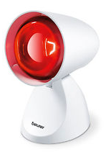
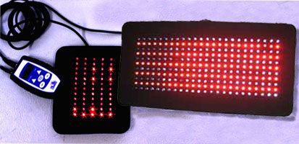
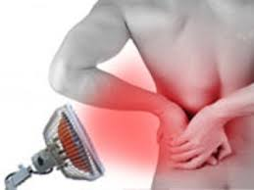
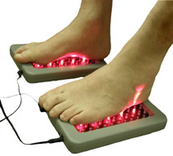
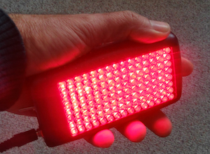
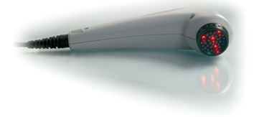
Use
©
Infrared treatment light
dr. Chris R. Mol, BME, NORTEC, 2015

Slide 7
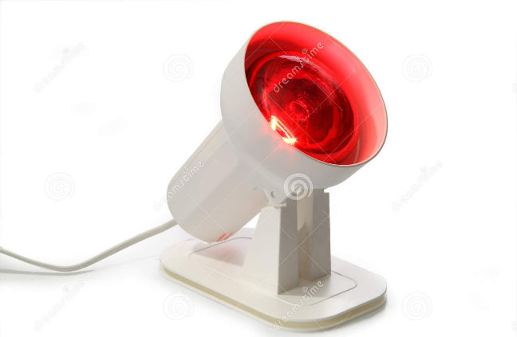
System Diagram
a timer is often included
©
Infrared treatment light
dr. Chris R. Mol, BME, NORTEC, 2015

Slide 8
Trouble shooting
find the correct replacement bulb(s)
broken wires
change batteries
….
©
Infrared treatment light
dr. Chris R. Mol, BME, NORTEC, 2015

Slide 9
Safety Considerations
too much heat (too long treatment)
acute joint injuries
potential damage of the radiation to the eyes
not to continue after prolonged pain sensation
©
Infrared treatment light
dr. Chris R. Mol, BME, NORTEC, 2015

Slide 10
END
The creation of this presentation was supported by a grant from THET:
see https://www.thet.org/

